Slide 1

REAL TIME DENOISING WITH DL: Milestone 1
Ryan Tong, Tom Donnelly, Shixuan Fang
Advised by Liam Dugan

Slide 2
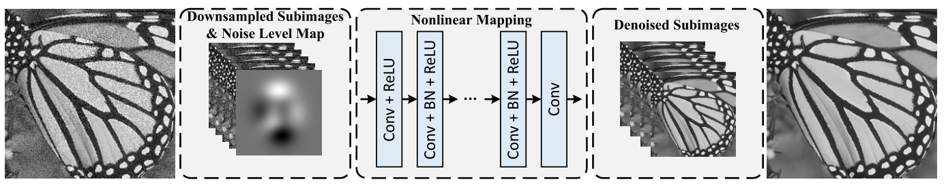
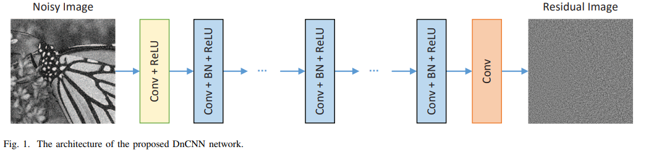
Background
Real time CNN denoising integrated into CUDA Path Tracer / Denoiser homework
Super-resolution to generate a higher resolution image with less samples
Continuing to be used extensively in video games
Denoising with ML
FFDNet & DnCNN
Both are able to achieve real time performance
SOTA performance on denoising benchmarks
Want to implement with cuDNN and cuBLAS in CUDA, optimize for real time

Slide 3
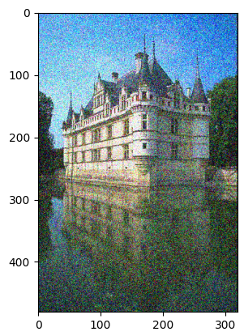
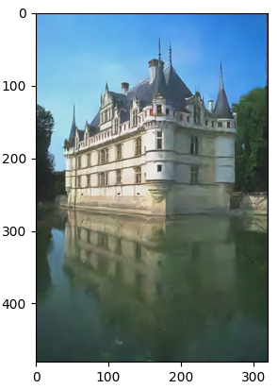
Progress
Integration of cuDNN and opencv libraries into CUDA path tracer
Found and verified trained dnCNN model
Weight loading in cuDNN
Pytorch .pth file -> .csv -> kernel weights in cuDNN
First lines of cuDNN code
Understanding of dnCNN and FFDNet papers
FFDNet net uses a downsampling method called pixel shuffle/unshuffle

Slide 4
Next Steps
Verification of weight loading
Run an example image through first convolutional filter in pytorch and cuDNN
Make sure outputs are the same to be sure we loaded weights in correctly
Finish weight loading pipeline to load the complete dnCNN model
Try forward pass of model in dnCNN
Evaluate results
Implement pixel shuffle/unshuffle used in FFDNet with CUDA kernel
Validate the implementation with pytorch
Data collection
Pipeline to generate noisy and complete scenes from path tracer to be used as fine-tuning data
Pytorch training pipeline to use this image set to fine-tune model

